Slide 1
Chapter 3
Water and the Fitness of
the Environment

Slide 2
Overview: The Molecule That Supports All of Life
Water is the biological medium on Earth
All living organisms require water more than any other substance
Most cells are surrounded by water, and cells themselves are about 70–95% water
The abundance of water is the main reason the Earth is habitable
Copyright © 2008 Pearson Education, Inc., publishing as Pearson Benjamin Cummings

Slide 3
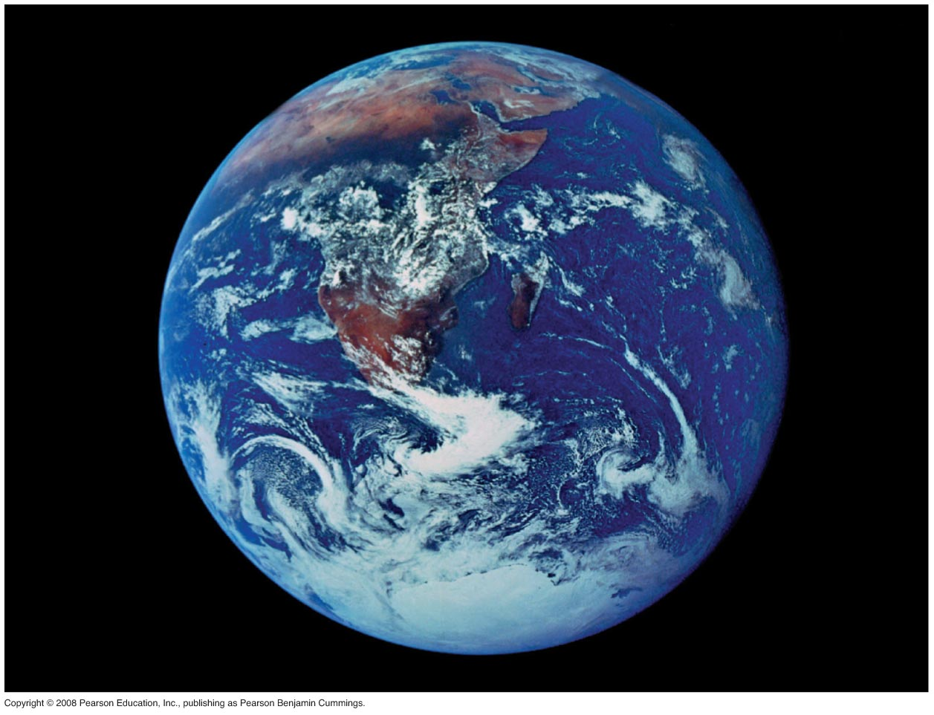
Fig. 3-1
Notes:
Figure 3.1 Why does the abundance of water allow life to exist on the planet Earth?

Slide 4

Concept 3.1: The polarity of water molecules results in hydrogen bonding
The water molecule is a polar molecule: The opposite ends have opposite charges
Polarity allows water molecules to form hydrogen bonds with each other
Animation: Water Structure
Copyright © 2008 Pearson Education, Inc., publishing as Pearson Benjamin Cummings

Slide 5
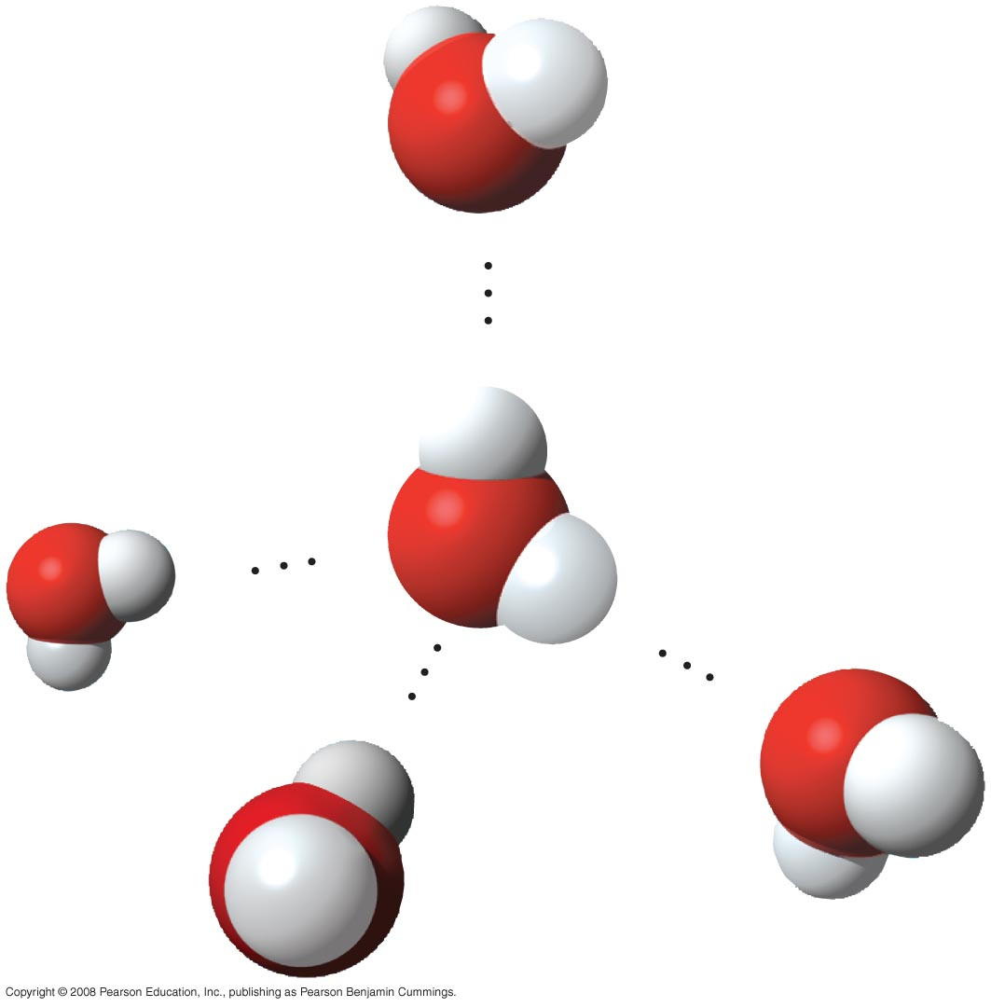
Fig. 3-2
δ –
Hydrogen
bond
δ +
H
——
O
δ –
——
δ +
H
δ –
δ +
δ –
δ +
Notes:
Figure 3.2 Hydrogen bonds between water molecules

Slide 6
Concept 3.2: Four emergent properties of water contribute to Earth’s fitness for life
Four of water’s properties that facilitate an environment for life are:
  Cohesive behavior
  Ability to moderate temperature
  Expansion upon freezing
  Versatility as a solvent
Copyright © 2008 Pearson Education, Inc., publishing as Pearson Benjamin Cummings

Slide 7
Cohesion
Collectively, hydrogen bonds hold water molecules together, a phenomenon called cohesion
Adhesion is an attraction between different substances, for example, between water and plant cell walls
Cohesion and adhesion work together with transpiration to pull water up from the roots of plants.
Animation: Water Transport
Copyright © 2008 Pearson Education, Inc., publishing as Pearson Benjamin Cummings

Slide 8
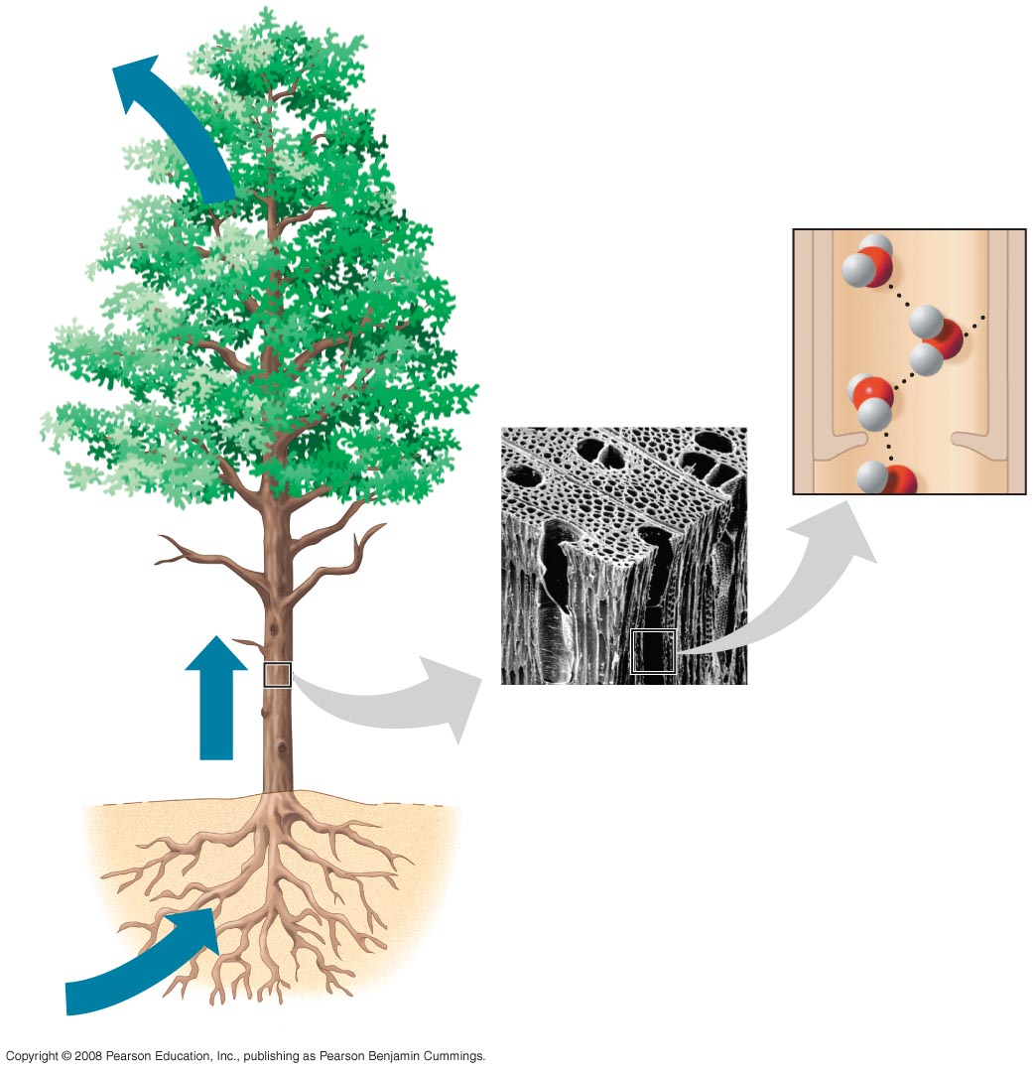
Fig. 3-3
Adhesion
Water-conducting
cells
Direction
of water
movement
Cohesion
150 µm
Notes:
Figure 3.3 Water transport in plants

Slide 9
Surface tension is a measure of how hard it is to break the surface of a liquid
Surface tension is related to cohesion
Copyright © 2008 Pearson Education, Inc., publishing as Pearson Benjamin Cummings

Slide 10
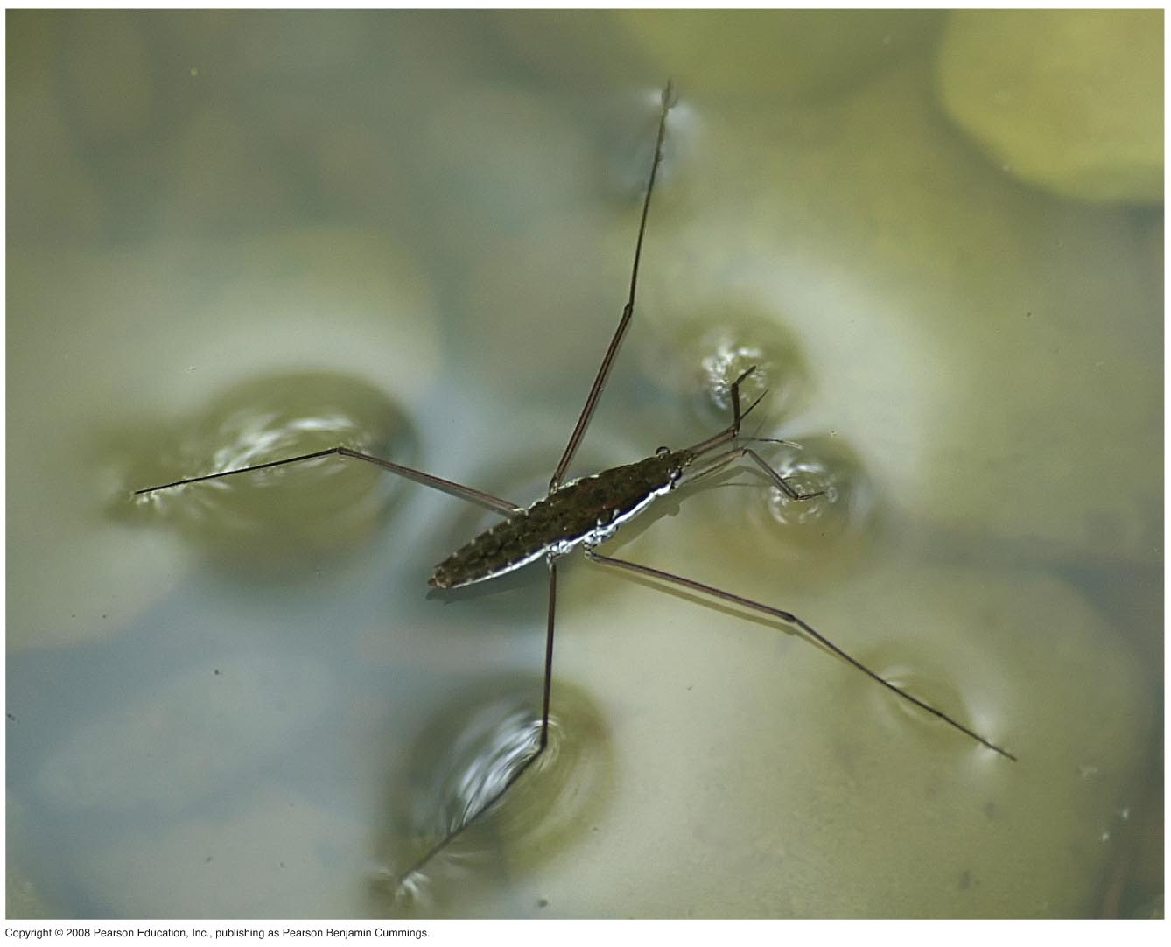
Fig. 3-4
Notes:
Figure 3.4 Walking on water

Slide 11
Evaporative Cooling
Evaporation is transformation of a substance from liquid to gas
Heat of vaporization is the heat a liquid must absorb for 1 g to be converted to gas
As a liquid evaporates, its remaining surface cools, a process called evaporative cooling
Evaporative cooling of water helps stabilize temperatures in organisms and bodies of water
Copyright © 2008 Pearson Education, Inc., publishing as Pearson Benjamin Cummings

Slide 12
Water’s High Specific Heat
The specific heat of a substance is the amount of heat that must be absorbed or lost for 1 g of that substance to change its temperature by 1ºC
The specific heat of water is 1 cal/g/ºC
Water resists changing its temperature because of its high specific heat
Copyright © 2008 Pearson Education, Inc., publishing as Pearson Benjamin Cummings

Slide 13
Moderation of Temperature
Water absorbs heat from warmer air and releases stored heat to cooler air
Water can absorb or release a large amount of heat with only a slight change in its own temperature
This makes water a great insulator and coolant for organisms.
(also helps with my Master Chef skills!)
Copyright © 2008 Pearson Education, Inc., publishing as Pearson Benjamin Cummings

Slide 14
Water’s high specific heat can be traced to hydrogen bonding
  Heat is absorbed when hydrogen bonds break
  Heat is released when hydrogen bonds form
The high specific heat of water minimizes temperature fluctuations to within limits that permit life
Copyright © 2008 Pearson Education, Inc., publishing as Pearson Benjamin Cummings

Slide 15
Heat and Temperature
Kinetic energy is the energy of motion
Heat is a measure of the total amount of kinetic energy due to molecular motion
Temperature measures the intensity of heat due to the average kinetic energy of molecules
Copyright © 2008 Pearson Education, Inc., publishing as Pearson Benjamin Cummings

Slide 16
The Celsius scale is a measure of temperature using Celsius degrees (°C)
A calorie (cal) is the amount of heat required to raise the temperature of 1 g of water by 1°C
The “calories” on food packages are actually kilocalories (kcal), where 1 kcal = 1,000 cal
The joule (J) is another unit of energy where
1 J = 0.239 cal, or 1 cal = 4.184 J
Copyright © 2008 Pearson Education, Inc., publishing as Pearson Benjamin Cummings

Slide 17
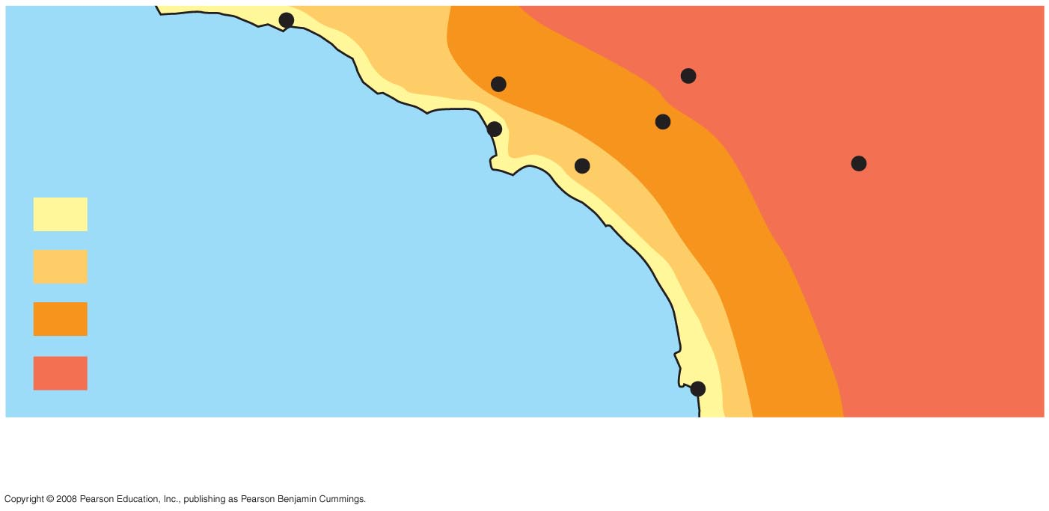
Fig. 3-5
Burbank
90°
San Bernardino
100°
Santa Barbara 73°
Los Angeles
(Airport) 75°
Riverside 96°
Santa Ana
84°
Palm Springs
106°
70s (°F)
80s
Pacific Ocean
90s
100s
San Diego 72°
40 miles
Water has a HUGE effect on climate because of this!
Notes:
Figure 3.5 The effect of a large body of water on climate

Slide 18
Insulation of Bodies of Water by Floating Ice
Ice floats in liquid water because hydrogen bonds in ice are more “ordered,” making ice less dense
Water reaches its greatest density at 4°C
If ice sank, all bodies of water would eventually freeze solid, making life impossible on Earth
Copyright © 2008 Pearson Education, Inc., publishing as Pearson Benjamin Cummings

Slide 19
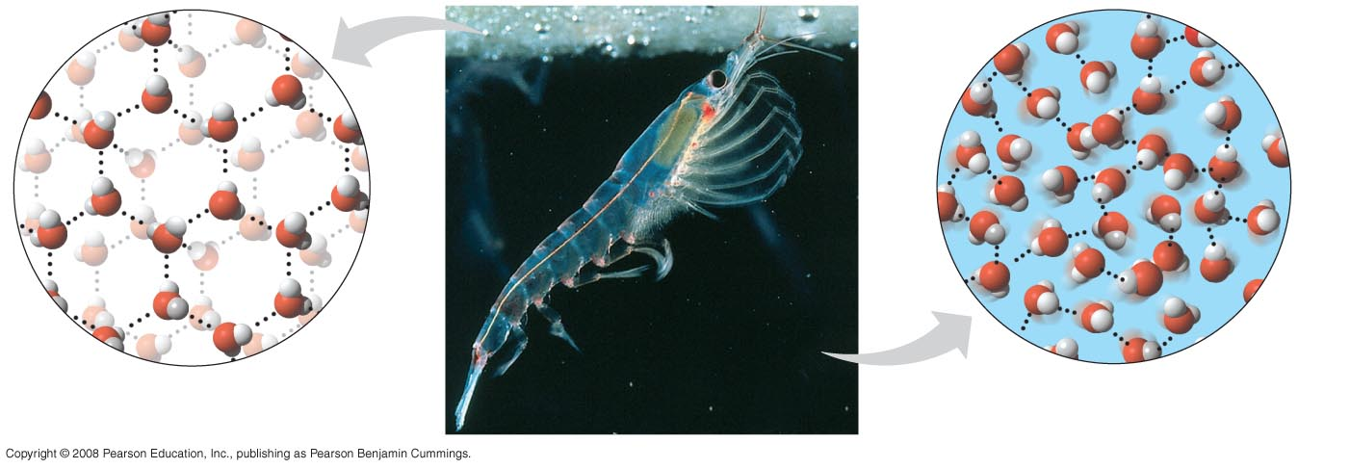
Fig. 3-6
Hydrogen
bond
Ice
Hydrogen bonds are stable
Liquid water
Hydrogen bonds break and re-form
Notes:
Figure 3.6 Ice: crystalline structure and floating barrier

Slide 20
The Solvent of Life
A solution is a liquid that is a homogeneous mixture of substances
A solvent is the dissolving agent of a solution
The solute is the substance that is dissolved
An aqueous solution is one in which water is the solvent
Copyright © 2008 Pearson Education, Inc., publishing as Pearson Benjamin Cummings

Slide 21
Water is a versatile solvent due to its polarity, which allows it to form hydrogen bonds easily
When an ionic compound is dissolved in water, each ion is surrounded by a sphere of water molecules called a hydration shell
Copyright © 2008 Pearson Education, Inc., publishing as Pearson Benjamin Cummings

Slide 22
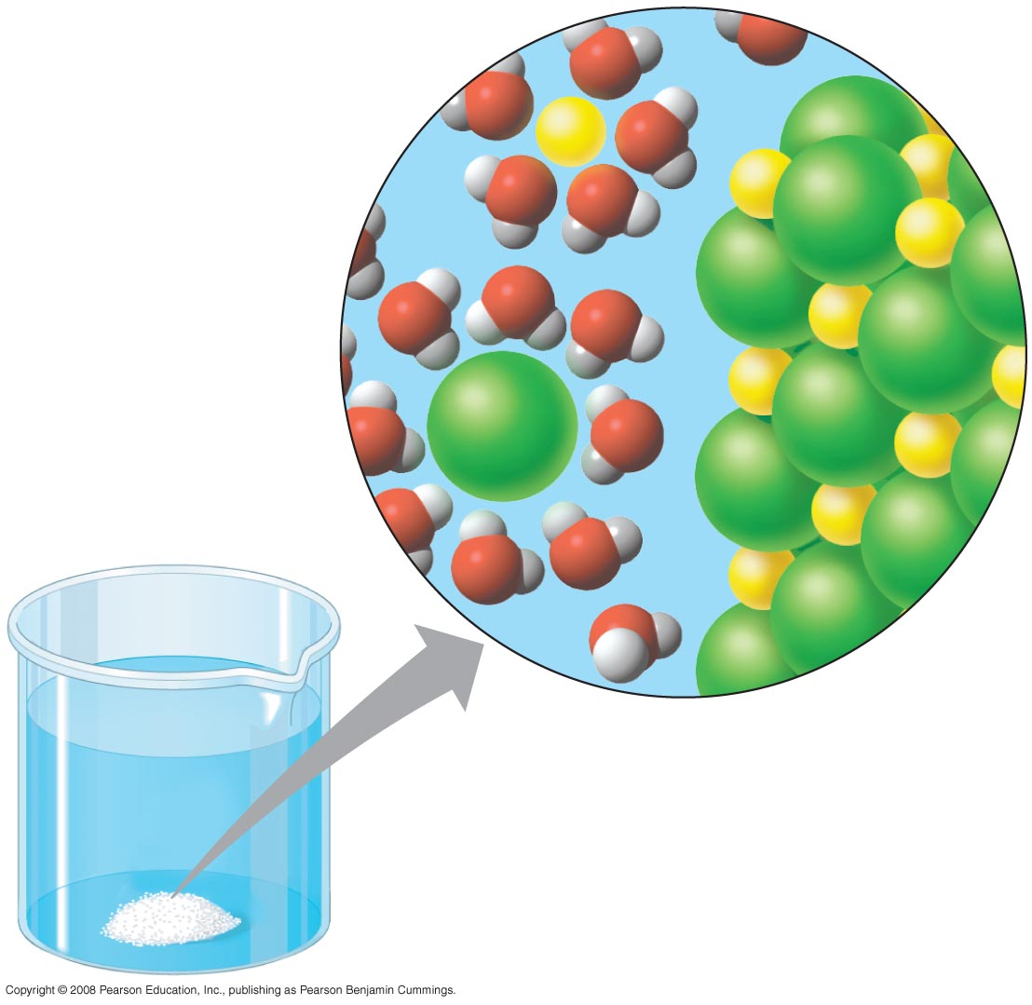
Fig. 3-7
–
Na
+
+
+
–
–
+
–
–
Na
+
–
+
+
Cl–
Cl–
+
–
–
+
–
+
–
–
Notes:
Figure 3.7 Table salt dissolving in water

Slide 23
Water can also dissolve compounds made of nonionic polar molecules
Even large polar molecules such as proteins can dissolve in water if they have ionic and polar regions
Copyright © 2008 Pearson Education, Inc., publishing as Pearson Benjamin Cummings

Slide 24
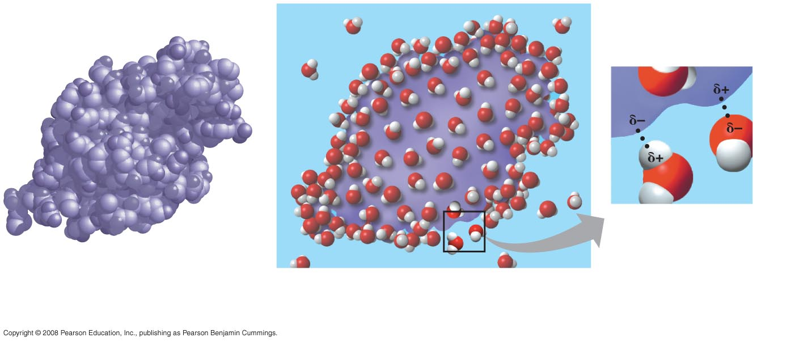
Fig. 3-8
(a) Lysozyme molecule in a
nonaqueous environment
(b) Lysozyme molecule (purple) in an aqueous
environment
(c) Ionic and polar regions
on the protein’s surface
attract water molecules.
Notes:
Figure 3.8 A water-soluble protein

Slide 25
Hydrophilic and Hydrophobic Substances
A hydrophilic substance is one that has an affinity for water
A hydrophobic substance is one that does not have an affinity for water
Oil molecules are hydrophobic because they have relatively nonpolar bonds
A colloid is a stable suspension of fine particles in a liquid
Copyright © 2008 Pearson Education, Inc., publishing as Pearson Benjamin Cummings

Slide 26
Solute Concentration in Aqueous Solutions
Most biochemical reactions occur in water
Chemical reactions depend on collisions of molecules and therefore on the concentration of solutes in an aqueous solution
Copyright © 2008 Pearson Education, Inc., publishing as Pearson Benjamin Cummings

Slide 27
Molecular mass is the sum of all masses of all atoms in a molecule
Numbers of molecules are usually measured in moles, where 1 mole (mol) = 6.02 x 10²³ molecules
Avogadro’s number and the unit dalton were defined such that 6.02 x 10²³ daltons = 1 g
Molarity (M) is the number of moles of solute per liter of solution
Copyright © 2008 Pearson Education, Inc., publishing as Pearson Benjamin Cummings

Slide 28
Concept 3.3: Acidic and basic conditions affect living organisms
A hydrogen atom in a hydrogen bond between two water molecules can shift from one to the other:
  The hydrogen atom leaves its electron behind and is transferred as a proton, or hydrogen ion (H⁺)
  The molecule with the extra proton is now a hydronium ion (H₃O⁺), though it is often represented as H⁺
  The molecule that lost the proton is now a hydroxide ion (OH–)
Copyright © 2008 Pearson Education, Inc., publishing as Pearson Benjamin Cummings

Slide 29
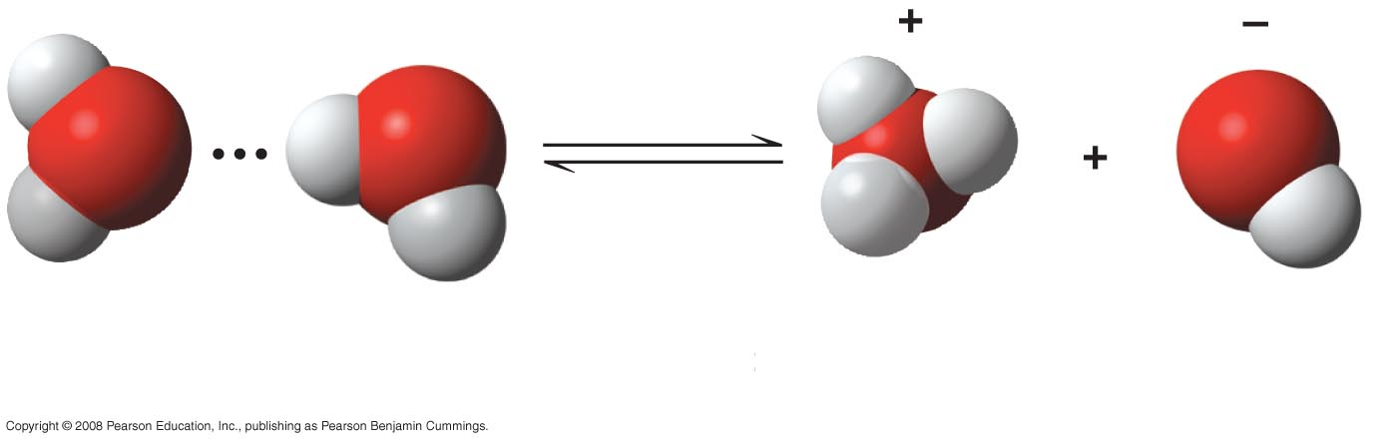
Fig. 3-UN2
H
H
O
H
O
O
H
O
H
H
H
H
2H₂O
Hydronium
ion (H₃O⁺)
Hydroxide
ion (OH–)
In pure water, the amount of these ions are equal and water is neutral

Slide 30

Sometimes a water molecule will disassociate into ions:
**In pure water, the amount of these ions are equal and so pure water is neutral.
Notes:
Called hydroxyl when OH covalently bonded to something else. Hydroxide when its an OH ion free.

Slide 31
Water is in a state of dynamic equilibrium in which water molecules dissociate at the same rate at which they are being reformed
Though statistically rare, the dissociation of water molecules has a great effect on organisms
Changes in concentrations of H⁺ and OH– can drastically affect the chemistry of a cell
Copyright © 2008 Pearson Education, Inc., publishing as Pearson Benjamin Cummings
Notes:
***About one in 550 million!

Slide 32
Effects of Changes in pH
Concentrations of H⁺ and OH– are equal in pure water
Adding certain solutes, called acids and bases, modifies the concentrations of H⁺ and OH–
Biologists use something called the pH scale to describe whether a solution is acidic or basic (the opposite of acidic)
Copyright © 2008 Pearson Education, Inc., publishing as Pearson Benjamin Cummings

Slide 33
Acids and Bases
An acid is any substance that increases the H⁺ concentration of a solution
A base is any substance that reduces the H⁺ concentration of a solution
Copyright © 2008 Pearson Education, Inc., publishing as Pearson Benjamin Cummings

Slide 34
The pH Scale
In any aqueous solution at 25°C the product of H⁺ and OH– is constant and can be written as [H⁺][OH–] = 10^{–14}
The pH of a solution is defined by the negative logarithm of H⁺ concentration, written as pH = –log [H⁺]
For a neutral aqueous solution [H⁺] is 10^{–7} = –(–7) = 7
Copyright © 2008 Pearson Education, Inc., publishing as Pearson Benjamin Cummings

Slide 35
What does that mean to you???
One jump on the pH scale is a jump of a power of 10!
Ex……If pH goes from 6 to 4, it is 100x more acidic! (NOT 2 x more acidic).

Slide 36
Acidic solutions have pH values less than 7
Basic solutions have pH values greater than 7
Most biological fluids have pH values in the range of 6 to 8
Copyright © 2008 Pearson Education, Inc., publishing as Pearson Benjamin Cummings

Slide 37
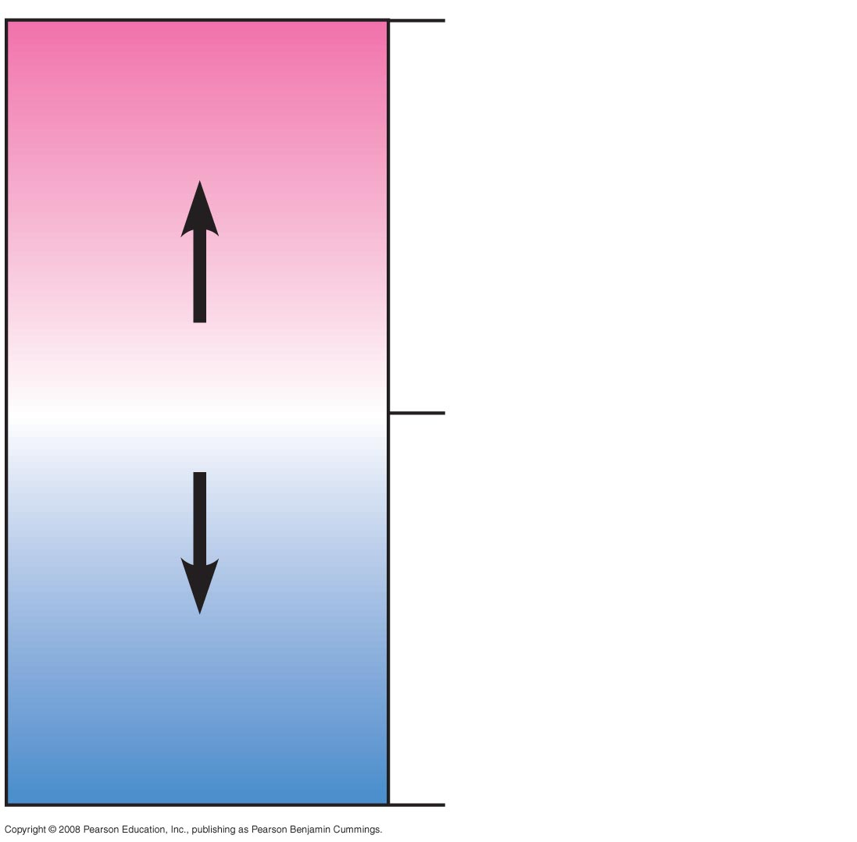
Fig. 3-UN5
0
Acidic
[H⁺] > [OH–]
Acids donate H⁺ in
aqueous solutions
Neutral
[H⁺] = [OH–]
7
Bases donate OH–
or accept H⁺ in
aqueous solutions
Basic
[H⁺] < [OH–]
14

Slide 38
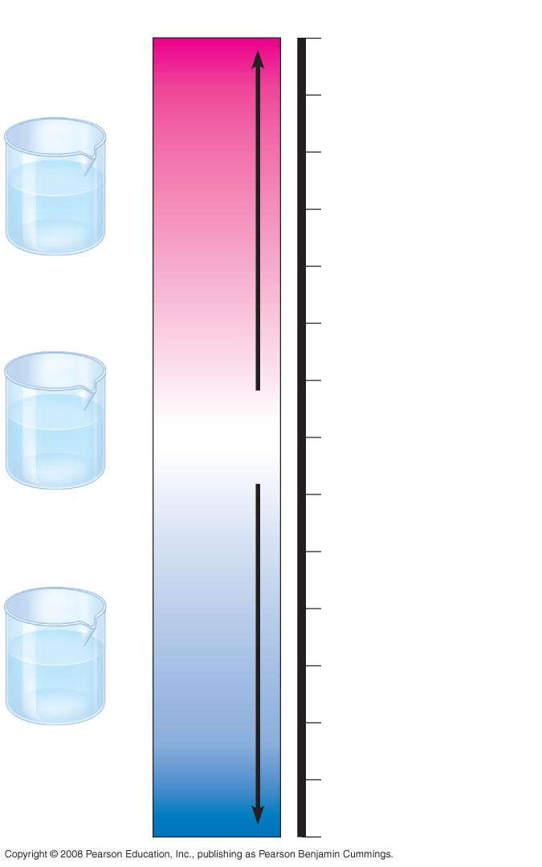
Fig. 3-9
pH Scale
0
1
Battery acid
2
Gastric juice,
lemon juice
H⁺
H⁺
H⁺
OH–
H⁺
3
Vinegar, beer,
wine, cola
OH–
H⁺
H⁺
Increasingly Acidic
[H⁺] > [OH–]
H⁺
H⁺
Acidic
solution
4
Tomato juice
5
Black coffee
Rainwater
6
Urine
OH–
OH–
Neutral
[H⁺] = [OH–]
Saliva
H⁺
H⁺
OH–
7
Pure water
OH–
OH–
H⁺
Human blood, tears
H⁺
H⁺
Neutral
solution
8
Seawater
9
Increasingly Basic
[H⁺] < [OH–]
10
OH–
Milk of magnesia
OH–
11
OH–
H⁺
OH–
Household ammonia
OH–
OH–
OH–
H⁺
12
Basic
solution
Household
bleach
13
Oven cleaner
14
Notes:
Figure 3.9 The pH scale and pH values of some aqueous solutions

Slide 39
Buffers
The internal pH of most living cells must remain close to pH 7
Buffers are substances that minimize changes in concentrations of H⁺ and OH– in a solution
Most buffers consist of an acid-base pair that reversibly combines with H⁺
Bicarbonate (HCO₃⁻) is a common buffer in our body
https://www.bing.com/videos/search?adlt=strict&q=buffer+carbonate+and+bicarbonate&view=detail&mid=563DECB350D4A2D336B0563DECB350D4A2D336B0&FORM=VIRE
Copyright © 2008 Pearson Education, Inc., publishing as Pearson Benjamin Cummings

Slide 40
Threats to Water Quality on Earth
Acid precipitation refers to rain, snow, or fog with a pH lower than 5.6
Acid precipitation is caused mainly by the mixing of different pollutants with water in the air and can fall at some distance from the source of pollutants
Acid precipitation can damage life in lakes and streams
Effects of acid precipitation on soil chemistry are contributing to the decline of some forests
Copyright © 2008 Pearson Education, Inc., publishing as Pearson Benjamin Cummings

Slide 41
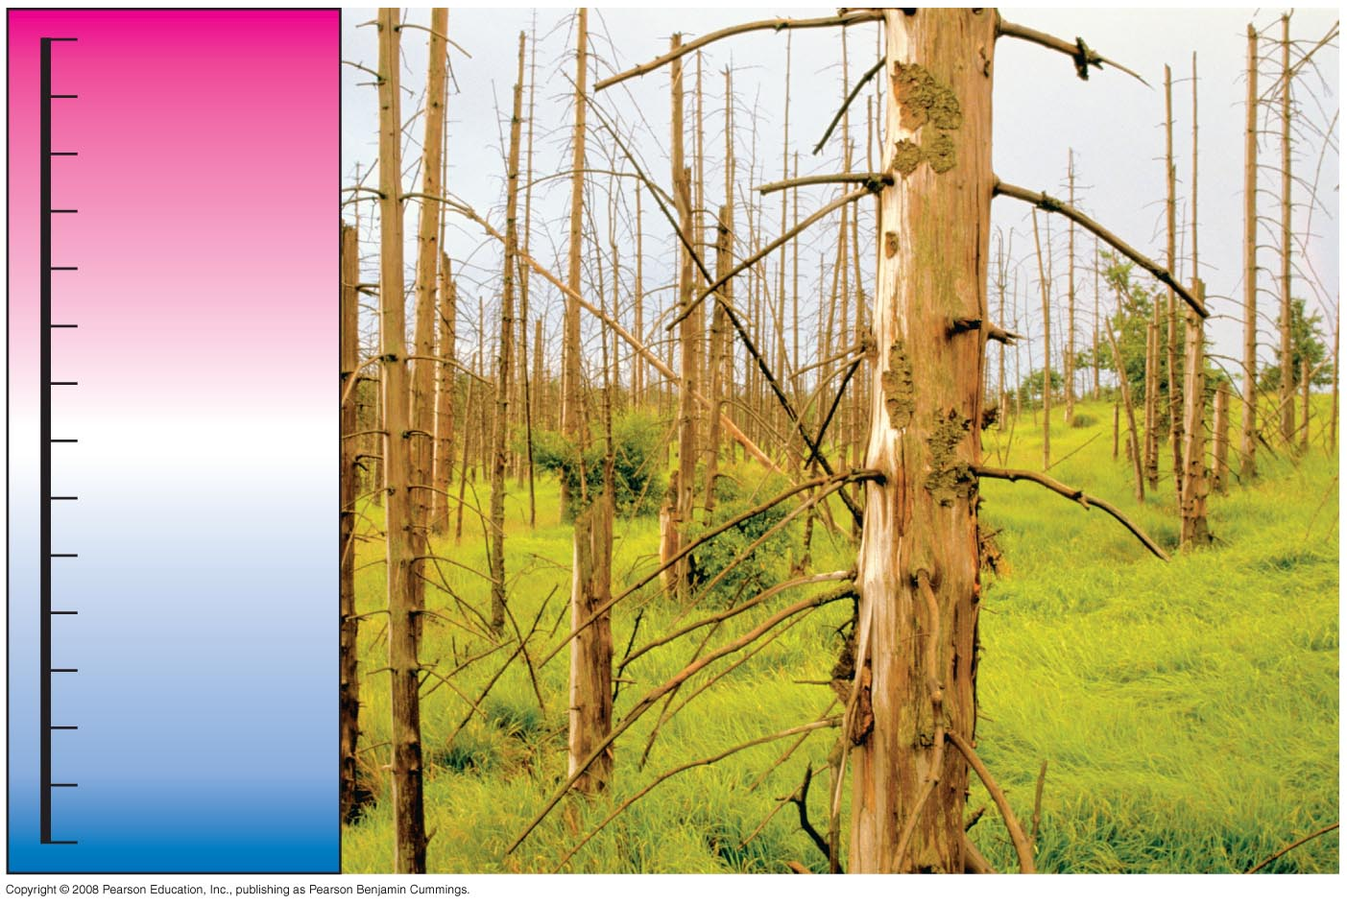
Fig. 3-10
0
More
acidic
1
2
Acid
rain
3
Acid
rain
4
5
Normal
rain
6
7
8
9
10
11
12
13
More
basic
14
Notes:
Figure 3.10 Acid precipitation and its effects on a forest

Slide 42
Human activities such as burning fossil fuels threaten water quality
CO₂ is released by fossil fuel combustion and contributes to:
  A warming of earth called the “greenhouse” effect
  Acidification of the oceans; this leads to a decrease in the ability of corals to form calcified reefs
Copyright © 2008 Pearson Education, Inc., publishing as Pearson Benjamin Cummings

Slide 43
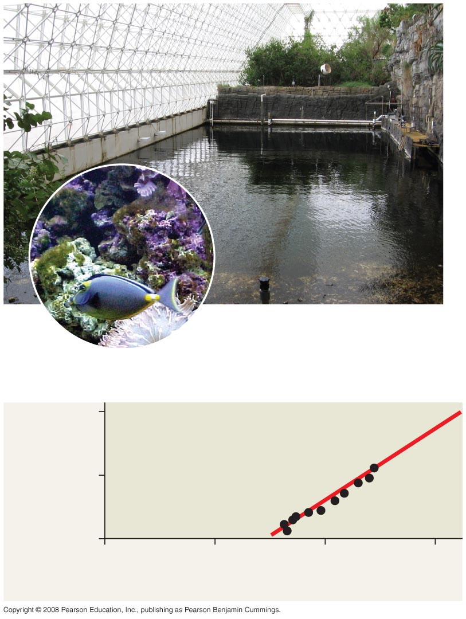
Fig. 3-11
EXPERIMENT
RESULTS
40
Calcification rate
(mmol CaCO₃
per m² per day)
20
0
150
200
250
300
[CO₃^{2–}] (µmol/kg)
Notes:
Figure 3.11 What is the effect of carbonate ion concentration on coral reef calcification?

Slide 44
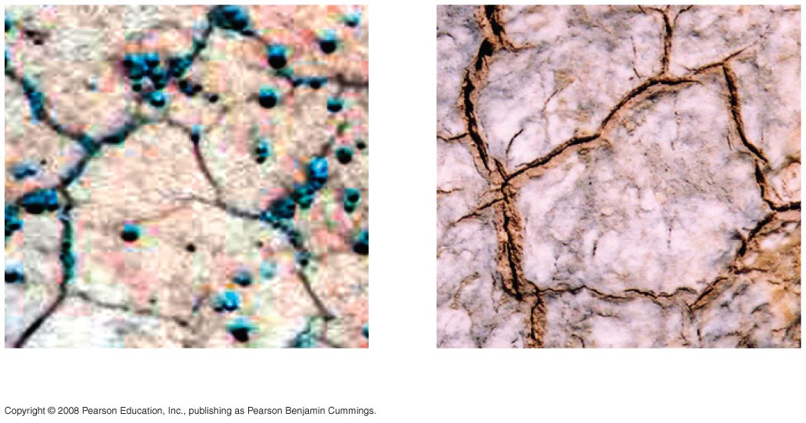
Fig. 3-UN6
Surface of Mars
Surface of Earth

Slide 45
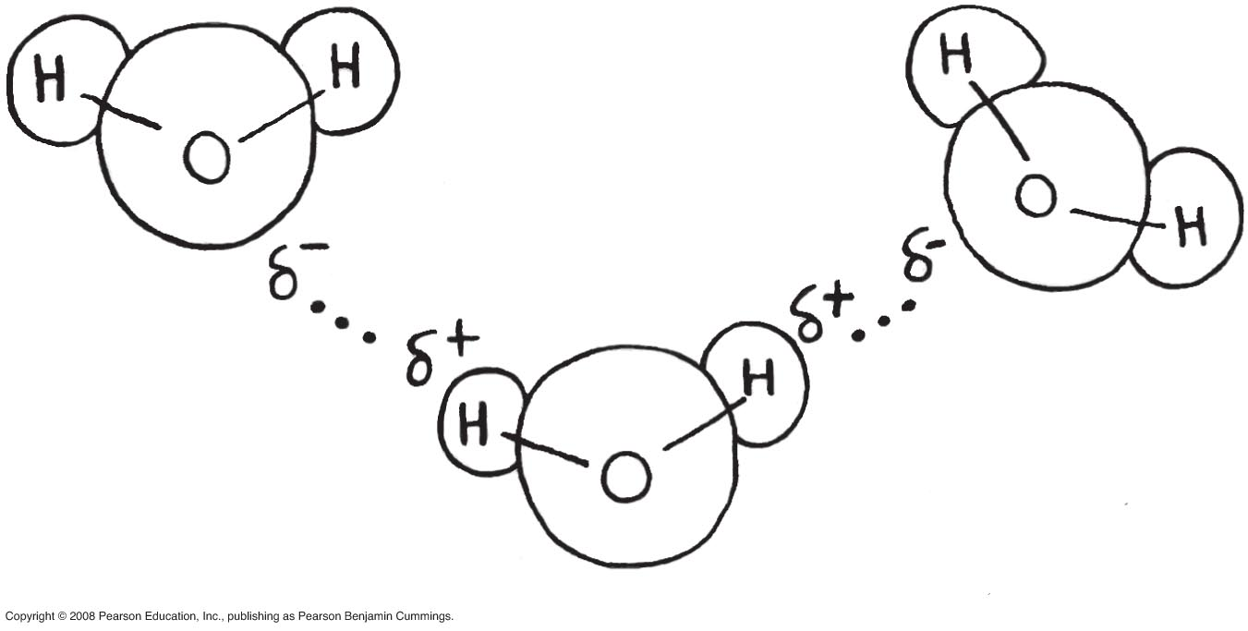
Fig. 3-UN7

Slide 46
You should now be able to:
List and explain the four properties of water that emerge as a result of its ability to form hydrogen bonds
Distinguish between the following sets of terms: hydrophobic and hydrophilic substances; a solute, a solvent, and a solution
Define acid, base, and pH
Explain how buffers work
Copyright © 2008 Pearson Education, Inc., publishing as Pearson Benjamin Cummings

